Slide 1
산업 컴퓨터비전 실제
Homework#1
산업인공지능학과
2024254008 신희권

Slide 2
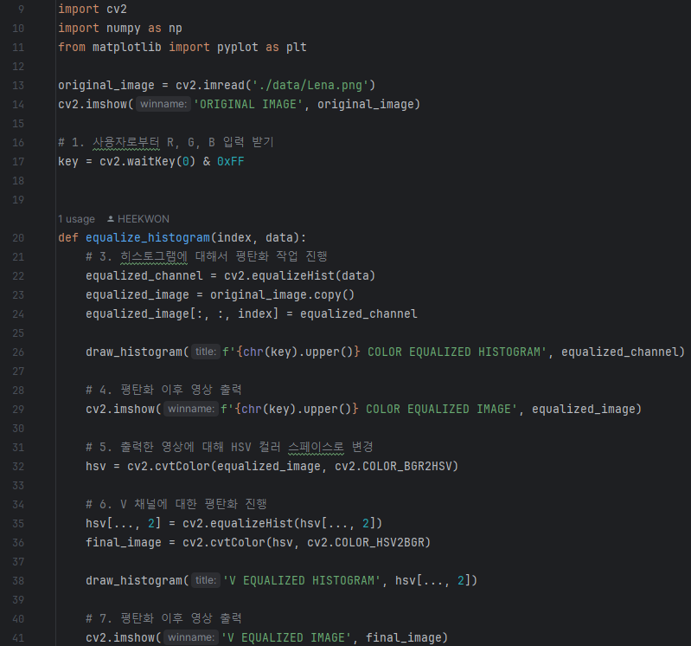
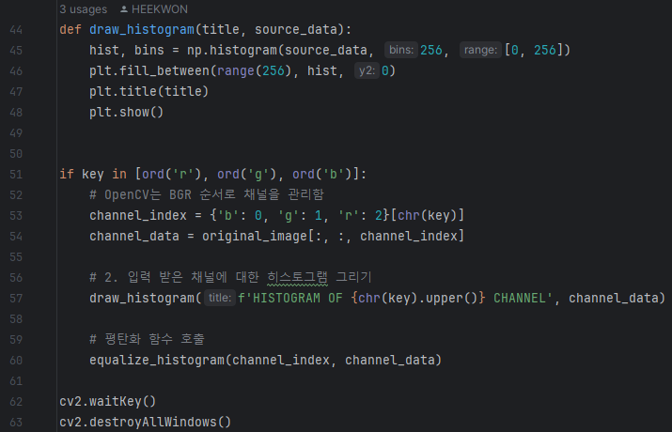
1. Histogram Equalization
Source Code

Slide 3
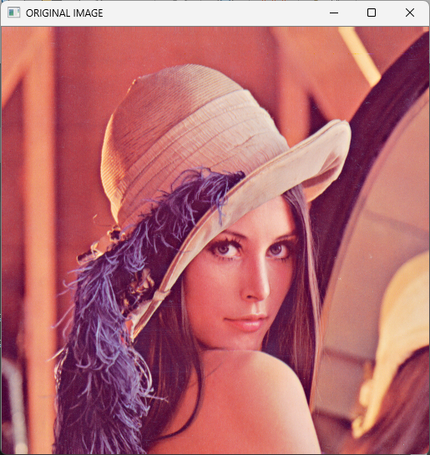
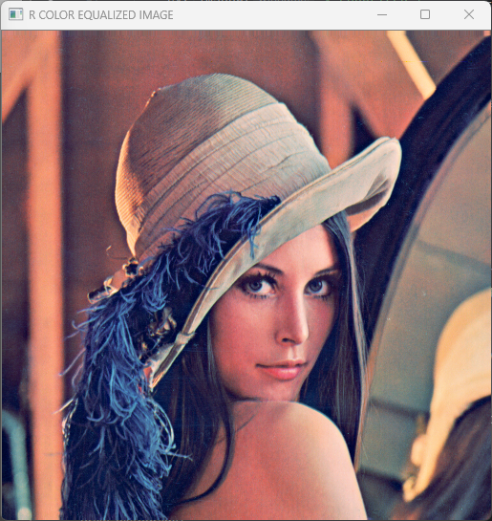
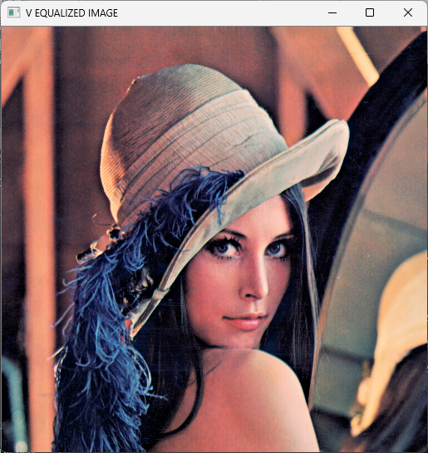
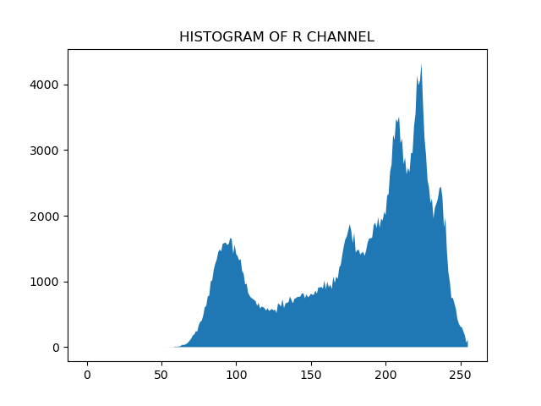
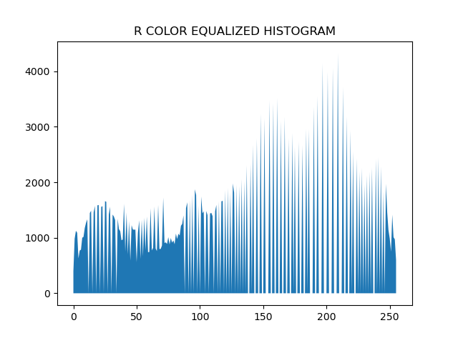
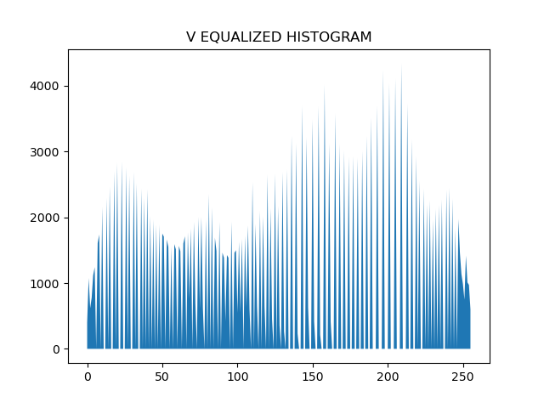
1. Histogram Equalization
Result(‘R’ 입력)

Slide 4
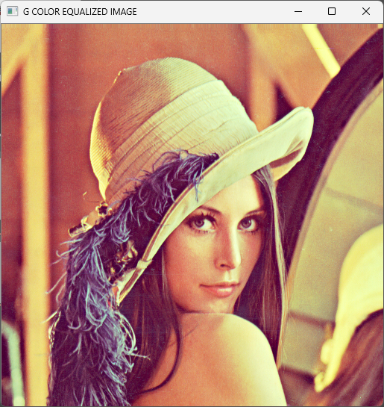
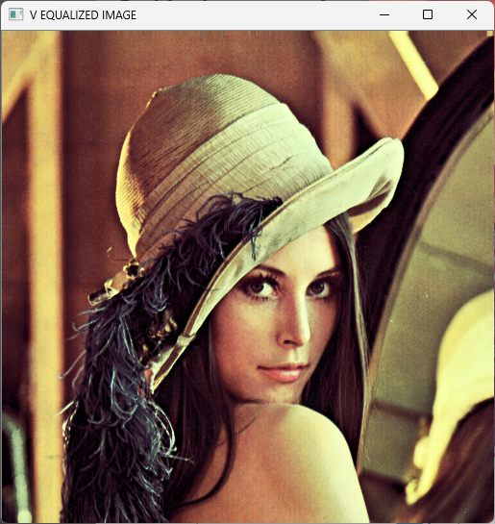
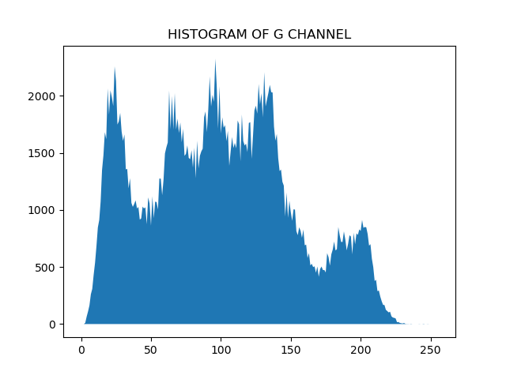
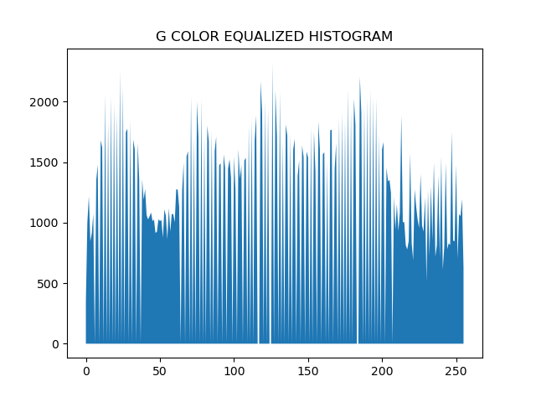
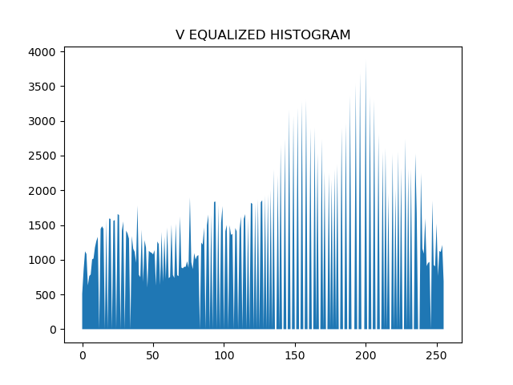
1. Histogram Equalization
Result(‘G’ 입력)

Slide 5
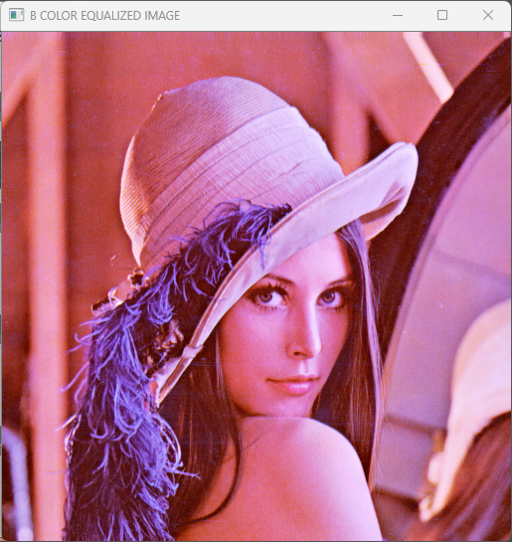
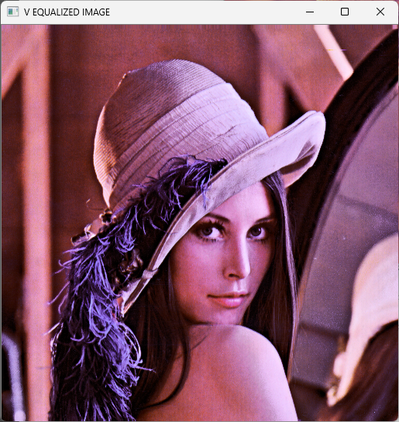
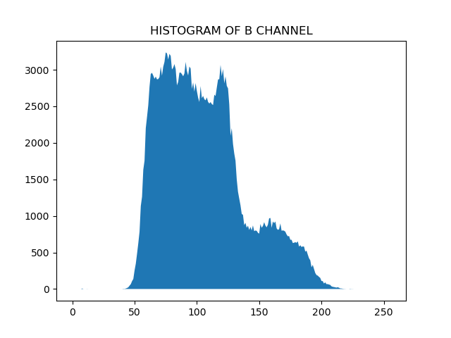
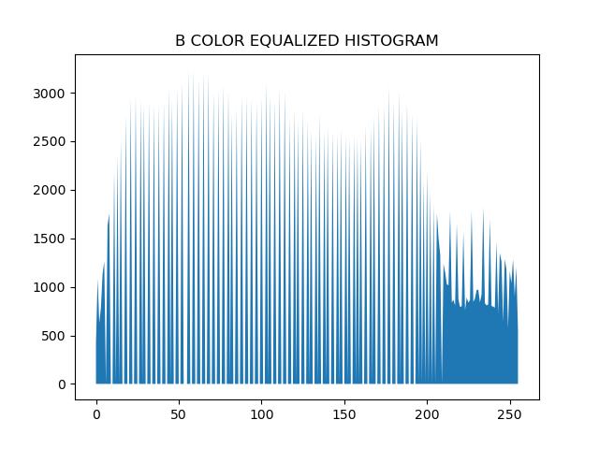
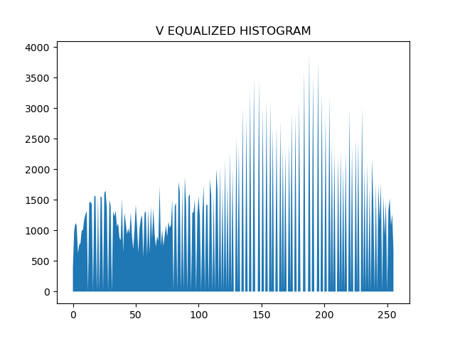
1. Histogram Equalization
Result(‘B’ 입력)

Slide 6
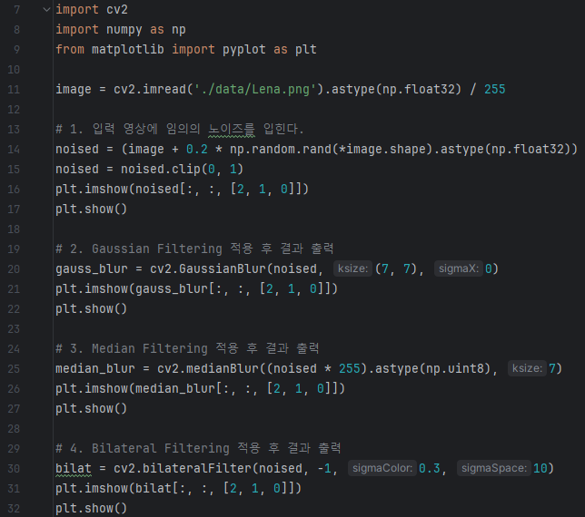
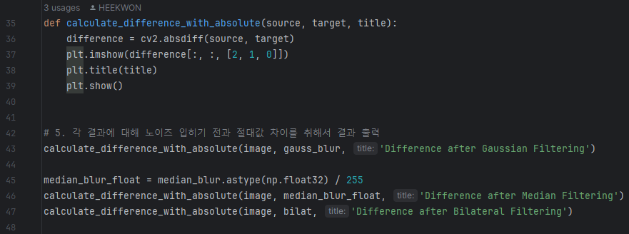
2. Spatial Domain Filtering
Source Code

Slide 7
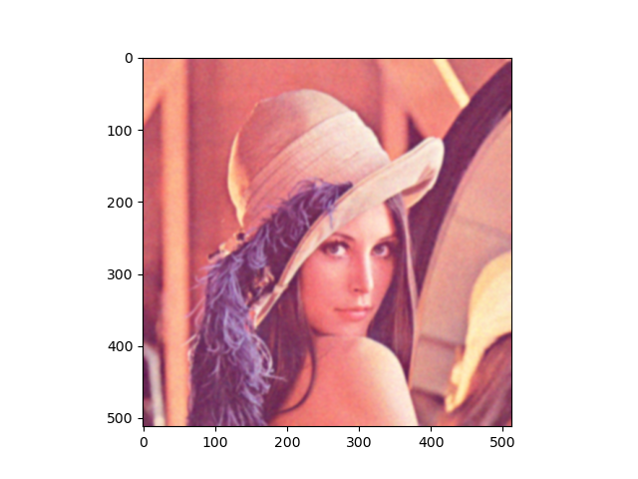
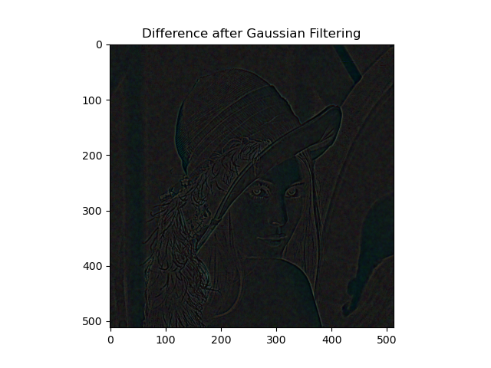


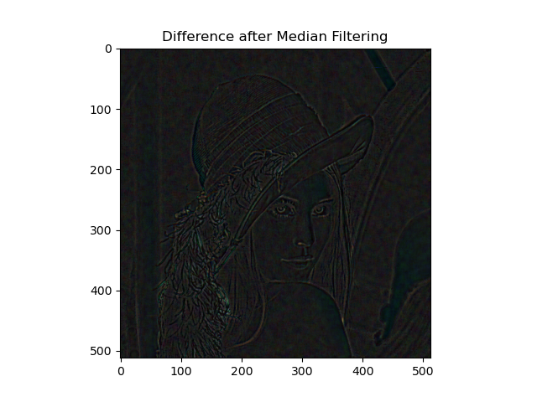
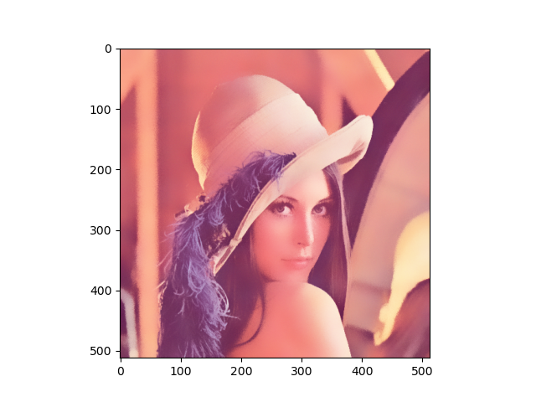
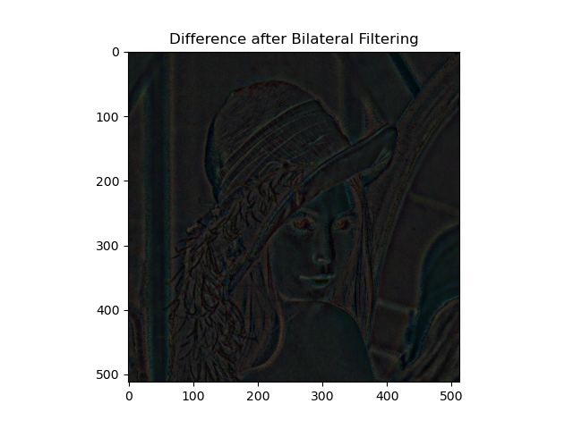
2. Spatial Domain Filtering
Result
Gaussian Blur
Absolute
Difference
Noised Image
Median Blur
Absolute
Difference
Bilateral Blur
Absolute
Difference

Slide 8
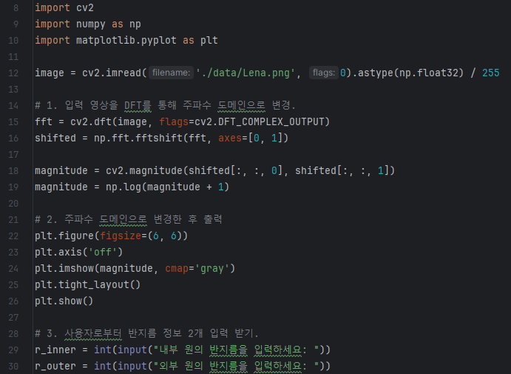
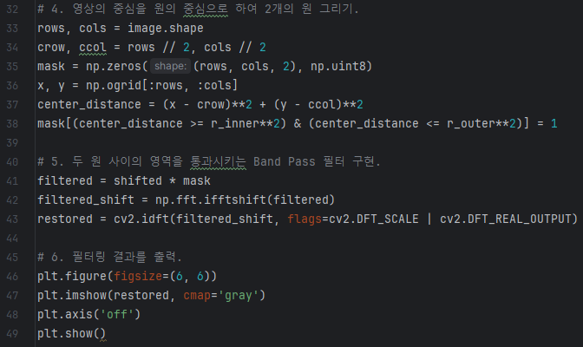
3. Frequency Domain Filtering
Source Code

Slide 9

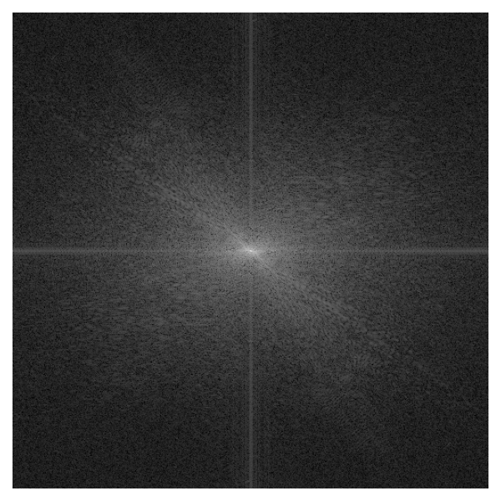

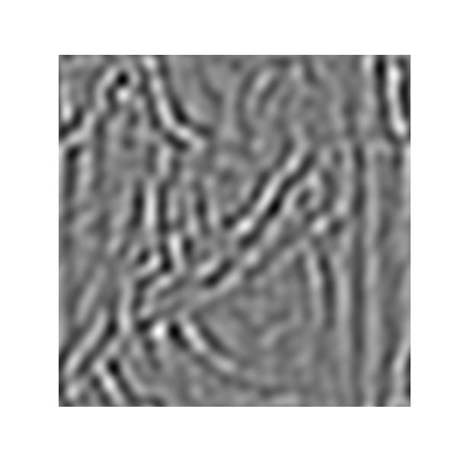
3. Frequency Domain Filtering
Result
Inner Circle Radius : 2
Outer Circle Radius : 4
Inner Circle Radius : 5
Outer Circle Radius : 10
Inner Circle Radius : 10
Outer Circle Radius : 20

Slide 10
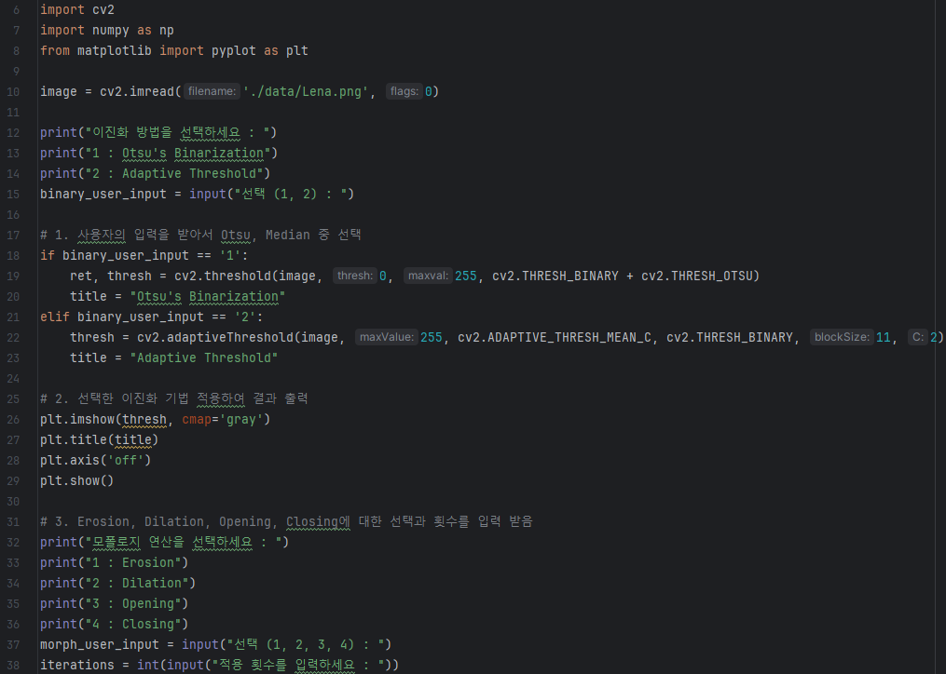
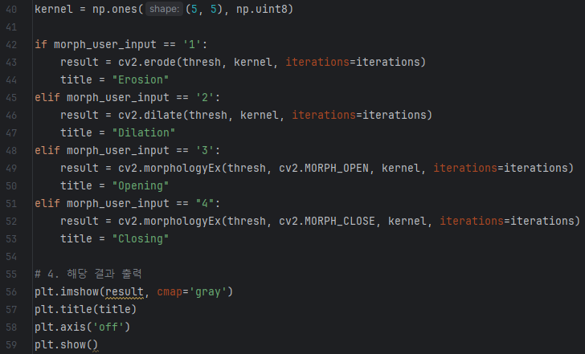
4. Morphological Filter
Source Code

Slide 11
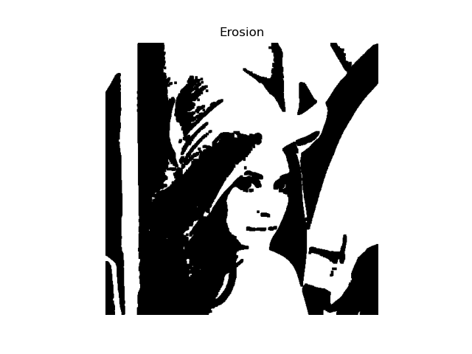
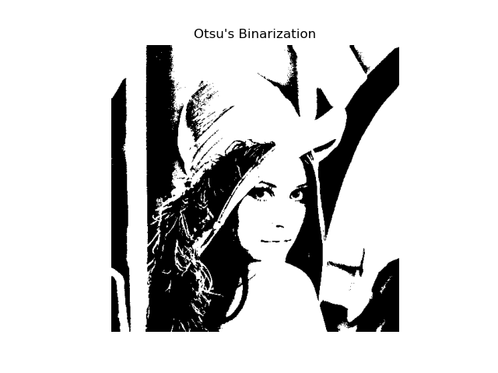
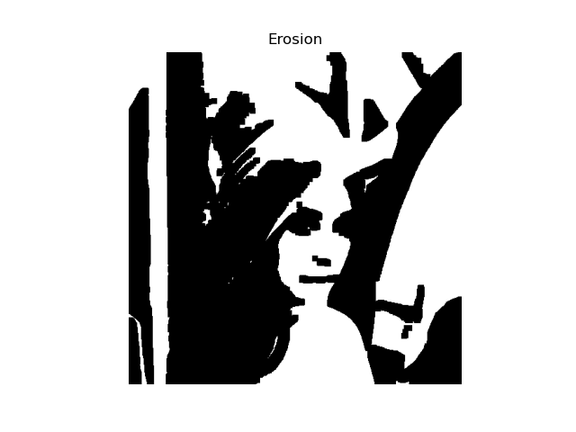
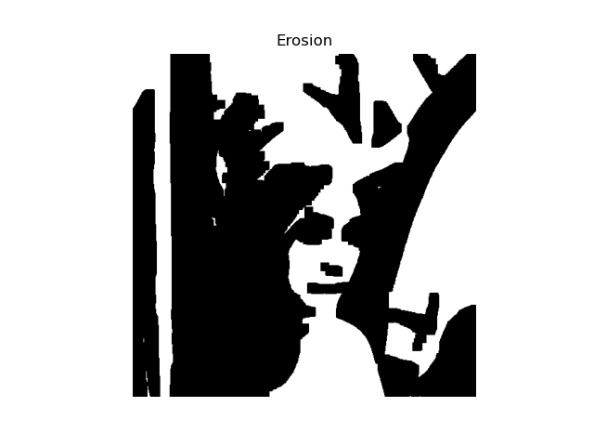
4. Morphological Filter
Result(Otsu Binarization & Erosion)
Erosion : 1
Erosion : 2
Erosion : 3

Slide 12
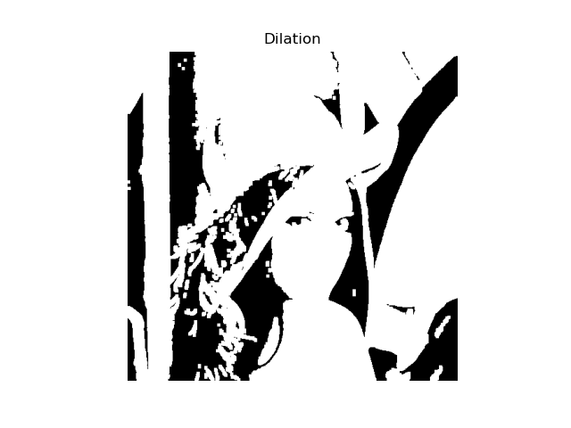
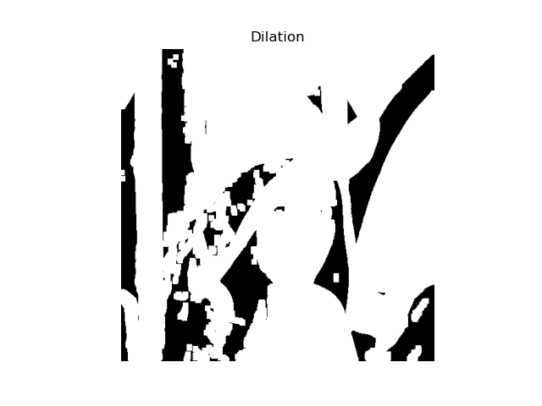
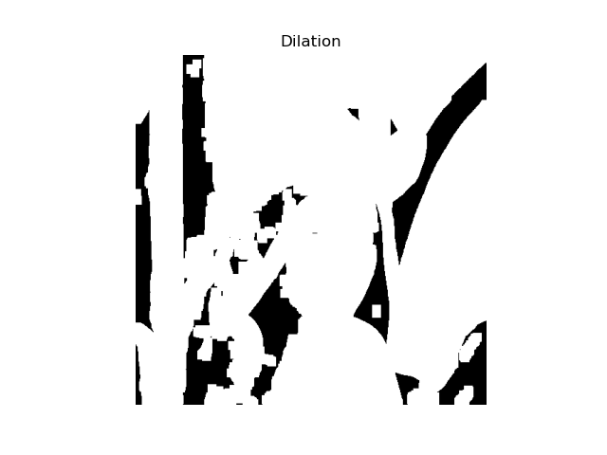
4. Morphological Filter
Result(Otsu Binarization & Dilation)
Dilation : 1
Dilation : 2
Dilation : 3

Slide 13
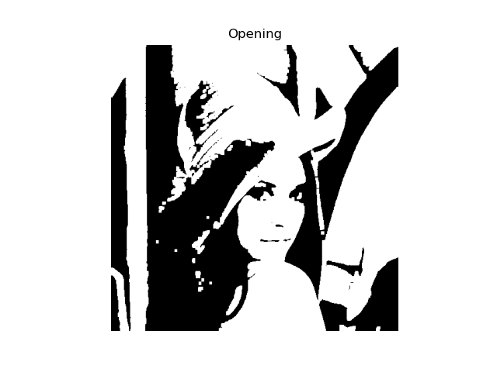

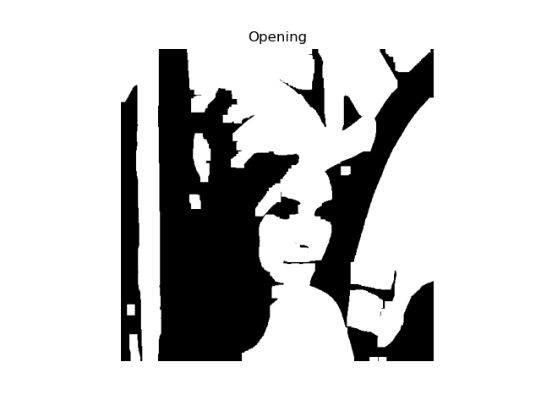
4. Morphological Filter
Result(Otsu Binarization & Opening)
Opening : 1
Opening : 2
Opening : 3

Slide 14
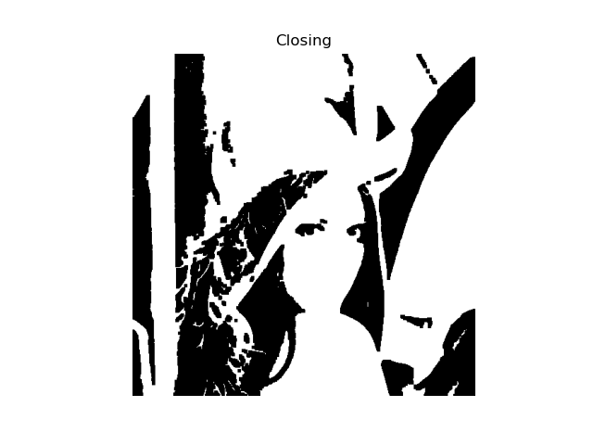


4. Morphological Filter
Result(Otsu Binarization & Closing)
Closing : 1
Closing : 2
Closing : 3

Slide 15
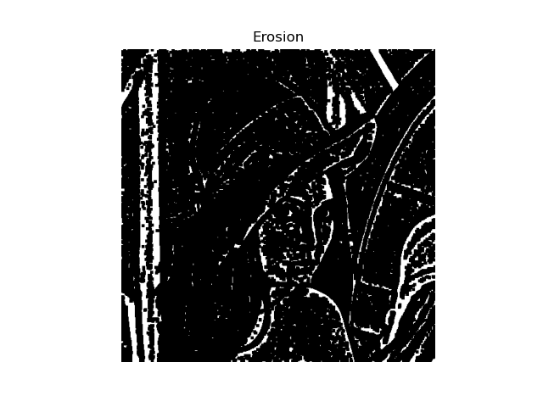
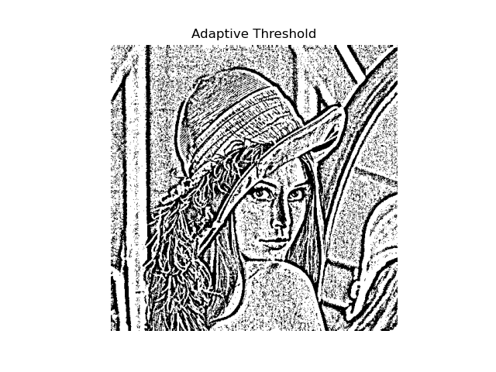
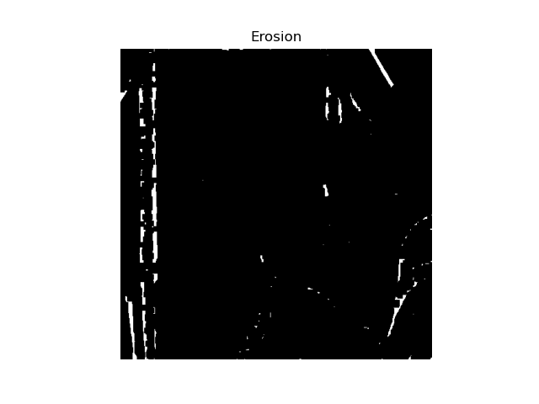
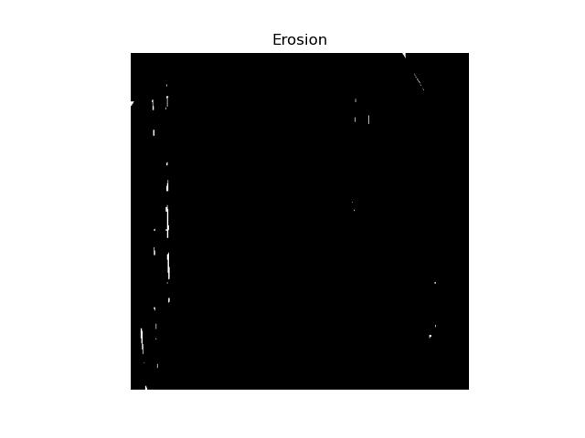
4. Morphological Filter
Result(Adaptive Threshold & Erosion)
Erosion : 1
Erosion : 2
Erosion : 3

Slide 16
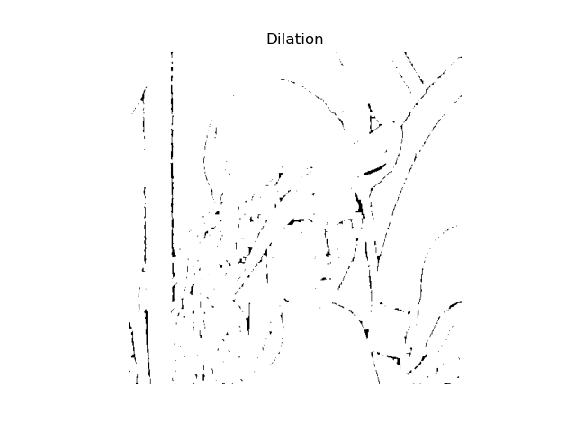

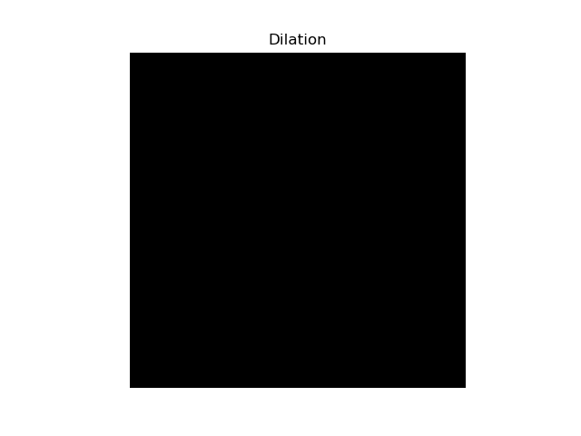
4. Morphological Filter
Result(Adaptive Threshold & Dilation)
Dilation : 1
Dilation : 2
Dilation : 3

Slide 17
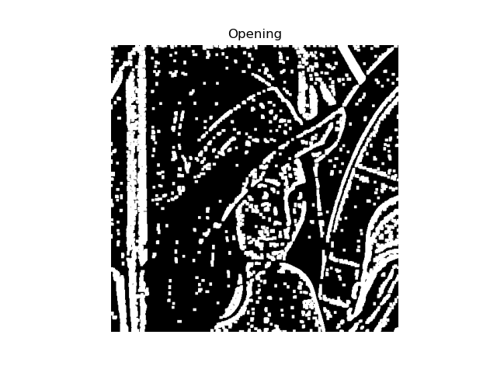
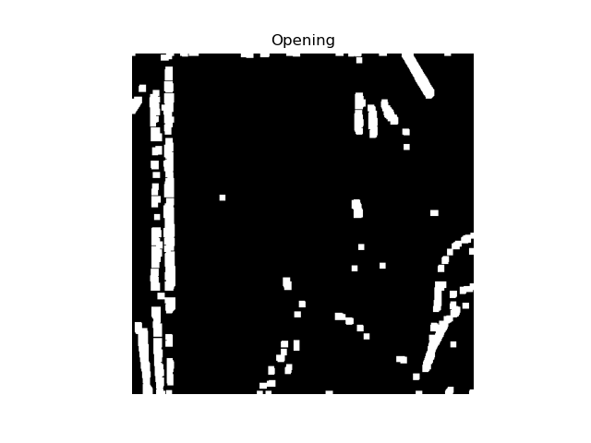
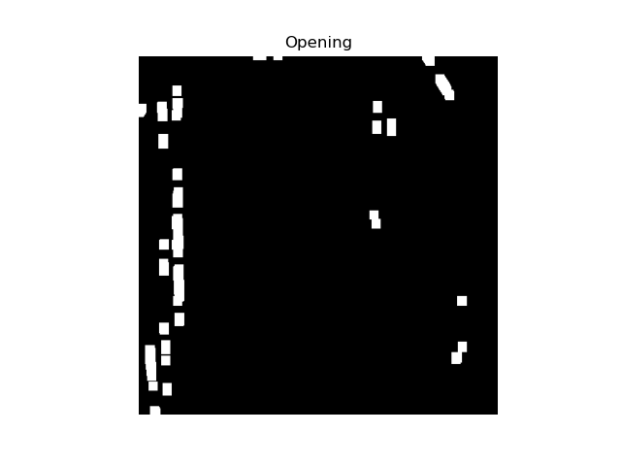
4. Morphological Filter
Result(Adaptive Threshold & Opening)
Opening : 1
Opening : 2
Opening : 3

Slide 18



4. Morphological Filter
Result(Adaptive Threshold & Closing)
Closing : 1
Closing : 2
Closing : 3

